Slide 1

AD-Hoc Analysis (consumer good)
AtliQ Hardware
Presented by Abhishek Patel

Slide 2
About
Atliq hardwares (imaginary company) is one of the leading computer hardware producers in India and has expanded well in other countries too.
However, the management noticed that they do not get enough insights to make quick and smart data-informed decisions.
They want to expand their data analytics team by adding several junior data analysts. Tony Sharma, their data analytics director, wanted to hire someone good at both tech and soft skills.
Hence, he decided to conduct A SQL challenge, which will help him understand both skills.

Slide 3
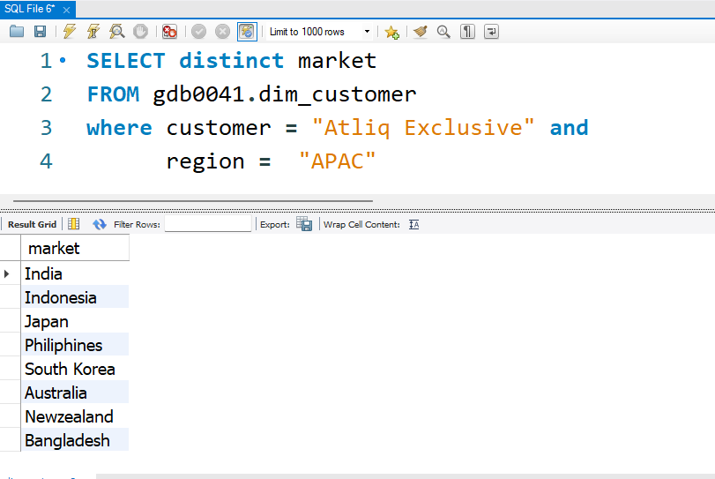
Task -1 . Provide the list of markets in which customer "Atliq Exclusive" operates its business in the APAC region.

Slide 4
Inside
Atliq Exclusive operates in 8 unique APAC markets across South Asia, Southeast Asia, East Asia, and Oceania and reflects a diversified regional presence balancing emerging and developed economies.

Slide 5
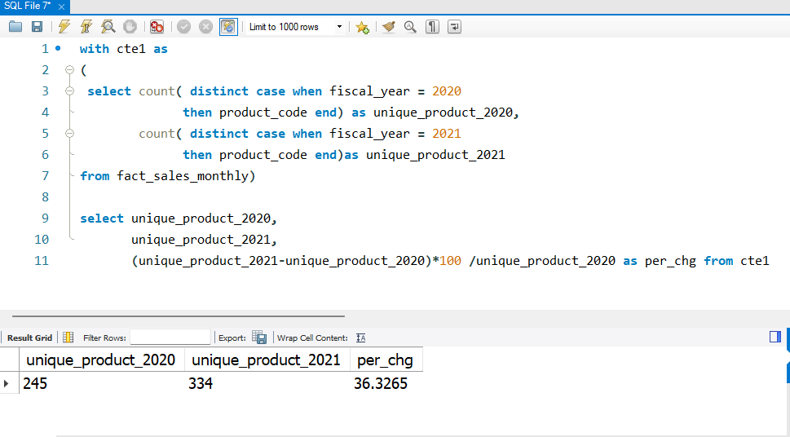
Task – 2 What is the percentage of unique product increase in 2021 vs. 2020? The final output contains these fields, unique_products_2020 ,unique_products_2021 ,percentage_chg

Slide 6
Inside
The number of unique products increased from 245 in 2020 to 334 in 2021, resulting in a 36.33% increase.
This indicates a significant expansion in product assortment in 2021 compared to 202

Slide 7
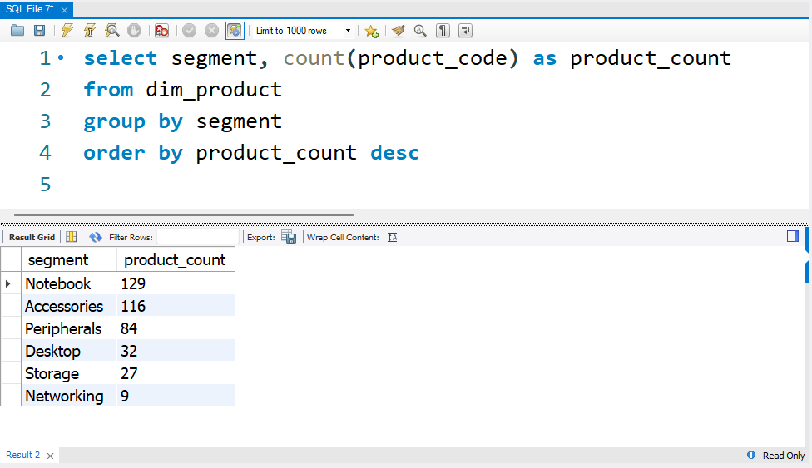
Task -3 Provide a report with all the unique product counts for each segment and sort them in descending order of product counts. The final output contains 2 fields, segment ,product_count

Slide 8
Inside
With 129 products, Notebook dominates the product portfolio, suggesting a strong focus on the portable computing market.
Accessories (116) and Peripherals (84) make up a large part of the product mix, indicating AtliQ is leveraging add-ons and complementary items for revenue growth. Desktop(32) ,Networking (9) and Storage (27) products are the least developed segments

Slide 9
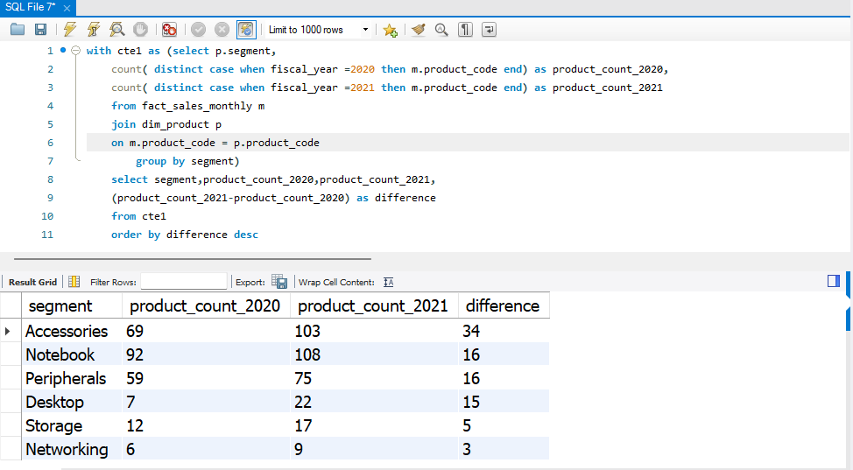
Task-4 Follow-up: Which segment had the most increase in unique products in 2021 vs 2020? The final output contains these fields, segment,product_count_2020, product_count_2021, difference

Slide 10
segment | 2020 | 2021 | Difference | Percentage
Accessories | 69 | 103 | 34 | 49.28
Notebook | 92 | 108 | 16 | 17.39
Peripherals | 59 | 75 | 16 | 27.12
Desktop | 7 | 22 | 15 | 214.29
Storage | 12 | 17 | 5 | 41.67
Networking | 6 | 9 | 3 | 50
Inside
Accessories segment saw the highest increase with +34 new unique products — a 49% growth.
Notebook and Peripherals each grew by +16, showing consistent innovation or diversification Desktop grew from 7 to 22 — a 214% increase.
Storage (+5) and Networking (+3) had low absolute and relative growth, possibly signaling.

Slide 11
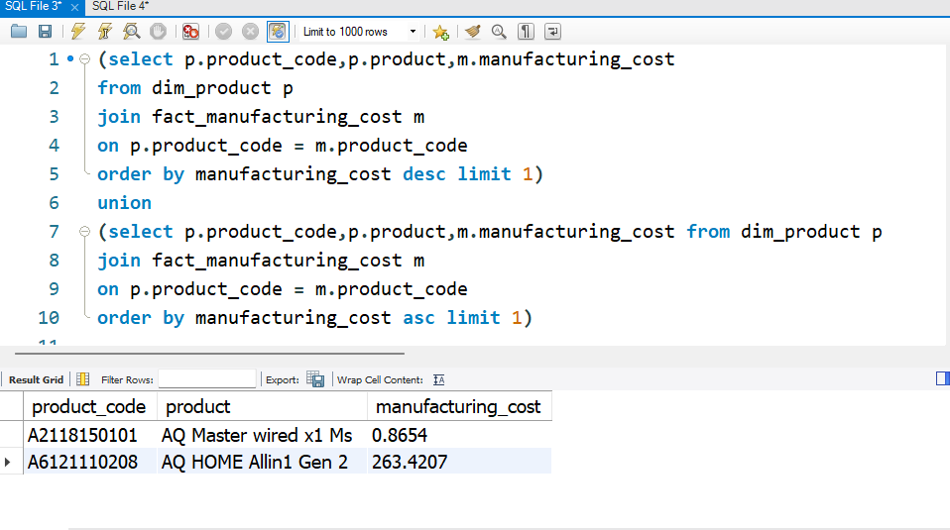
Task -5 Get the products that have the highest and lowest manufacturing costs. The final output should contain these fields, product_code ,product, manufacturing_cost,

Slide 12
The wide gap between highest and lowest manufacturing costs indicates a diversified product strategy, ranging from premium integrated devices to low cost mass-market accessories, supporting both value-driven and volume driven revenue streams
Inside

Slide 13
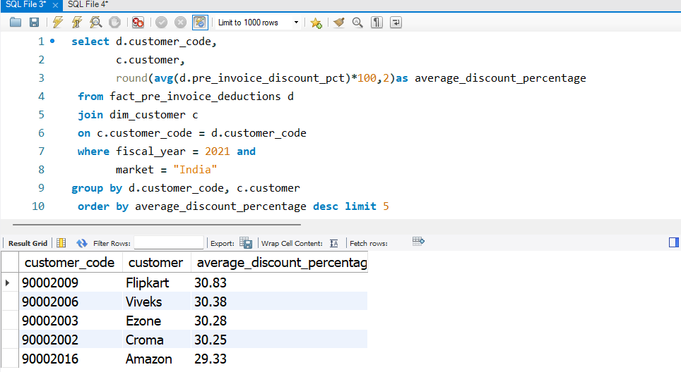
Task-6 Generate a report which contains the top 5 customers who received an average high pre_invoice_discount_pct for the fiscal year 2021 and in the Indian market. The final output contains these fields, customer_code, customer ,average_discount_percentage

Slide 14
Inside
`
Flipkart Receives the Highest Avg Discount (30.83%)
Amazon Receives the Lowest (29.33%)
Top 4 Customers Are All Above 30

Slide 15
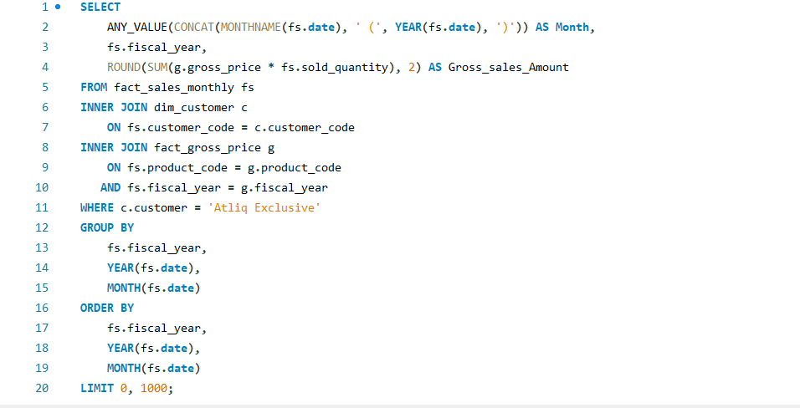
Task-7 Get the complete report of the Gross sales amount for the customer “Atliq Exclusive” for each month . This analysis helps to get an idea of low and high-performing months and take strategic decisions. The final report contains these columns: Month ,Year ,Gross sales Amount

Slide 17
Inside
`
Atliq Exclusive experienced a sharp decline in sales during early 2020 due to market disruptions, with revenue dropping from around 4–5M to below 0.5M in March–April 2020. However, the business recovered strongly from mid-2020 and achieved exceptional growth thereafter, reaching a peak of 20.46M in November 2020. Post-recovery sales consistently remained more than double the pre pandemic average, indicating strong market demand, successful recovery strategies, and sustained business expansion

Slide 18
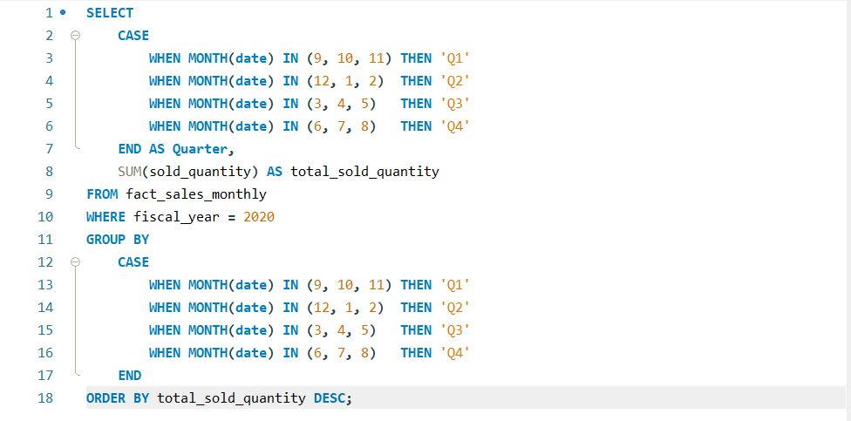
task-8 In which quarter of 2020, got the maximum total_sold_quantity? The final output contains these fields sorted by the total_sold_quantity, Quarter ,total_sold_quantity

Slide 19
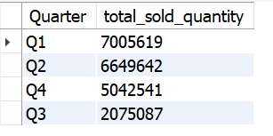
Inside
`
Q1 recorded the highest total sold quantity at 7.01 million units, making it the top-performing quarter in terms of volume.
Q1 may coincide with strong seasonal demand, new product launches, or effective promotional campaigns

Slide 20
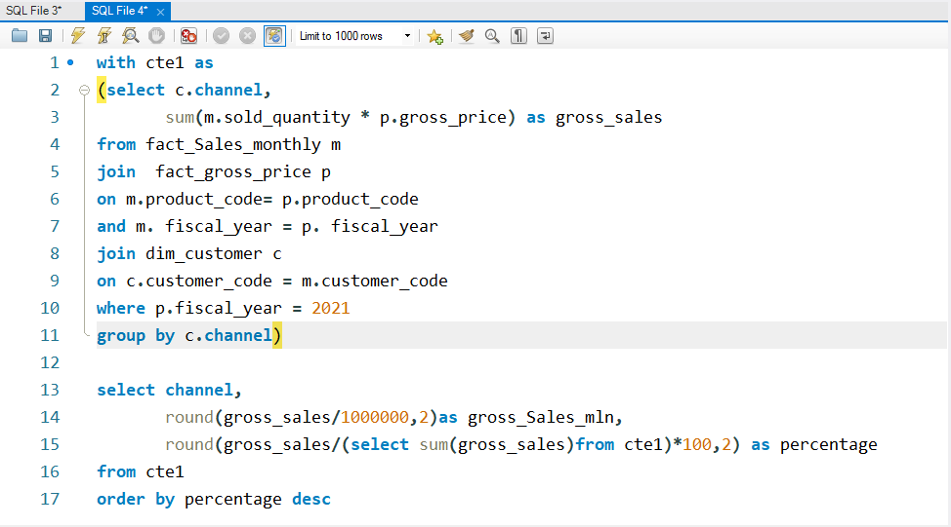
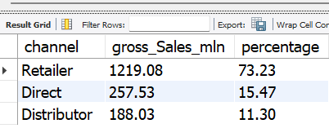
Task – 9 Which channel helped to bring more gross sales in the fiscal year 2021 and the percentage of contribution? The final output contains these fields, channel ,gross_sales_mln, percentage

Slide 21
Inside
`
Retailer channel dominates the sales with 1924.17M, accounting for 73% of total gross sales.
Direct channel follows distantly with 406.69M (16%).
The Distributor channel contributes the least, generating ₹297.18M (11%)

Slide 22
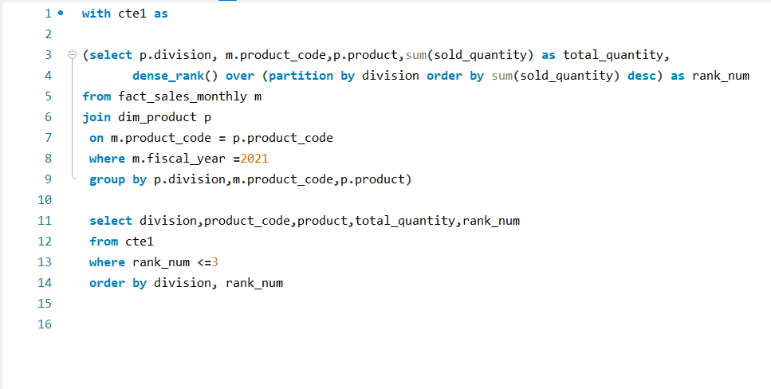
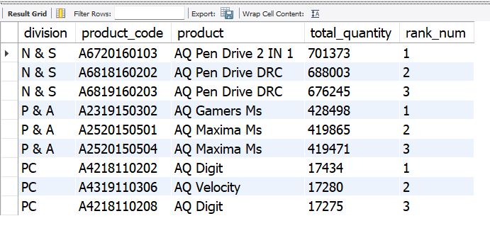
Task-10 Get the Top 3 products in each division that have a high total_sold_quantity in the fiscal_year 2021? The final output contains these fields, division product_code

Slide 23
Inside
`

Slide 24
Atliq exclusive highlights that the N & S division dominated total sold quantity, with product code A6720160103 (AQ pen drive 2 IN 1) securing rank 1 at 701,373 units sold.
The P & A division also showed strong performance through the AQ gamers ms and AQ maxima ms products,
while the PC division recorded comparatively lower sales volumes, indicating lower market demand within that segment.

Slide 25
Thank you very much

